Slide 1
Georgia Novel Coronavirus (COVID-19) Response
March 6, 2020

Slide 2
Georgia implements multisectoral response led by the Prime Minister and coordinated by Ministry for IDPs from the occupied territories, labor, health and social affairs
The Operational Response Plan for New Coronavirus (COVID19), adopted by the GoG Decree* includes the following measures to respond to a case of coronavirus disease:
Disease detection, identification, validation and risk assessment;
Laboratory testing;
Notification of responsible bodies;
Epi surveillance / response action;
Informing the public about the risks associated with coronavirus disease, elimination / mitigation of the effects and getting out of the situation.
Notes:
To ensure the multisectoral preparedness on the governmental level, Decree of the Government of Georgia #164 dated January 28, 2020 on “Approval of Measures to Prevent the Possible Spread of the New Coronavirus in Georgia and Approval of an Emergency Response Plan for Cases Caused by COVID-19” has been adopted (amended on February 26, with the GoG Decree #377).
The Operational Response Plan for New Coronavirus (COVID19), adopted by the GoG Decree, defines the commitments and responsibilities of the related agencies for national response measures. The Plan includes the following measures to respond to a case of coronavirus disease: disease detection, identification, validation and risk assessment; laboratory testing; notification of responsible bodies; Epi surveillance / response action; informing the public about the risks associated with coronavirus disease, elimination / mitigation of the effects and getting out of the situation.
The purpose of the Plan is to ensure the country preparedness to respond to coronavirus disease, both though preventive measures and in case of disease outbreak

Slide 3












Engaged Bodies, Obligations and Authority

Slide 4
Policy Measures
Governance and coordination:
High level response body established and action plans developed
Response coordination bodies established at responsible agencies
Prevention: travel restrictions
Entry screening at all entry points
Self isolation and quarantine
Epid surveillance
Diagnostic tests available at Lugar’s Center
Protocols and communication materials developed in several languages
Treatment facilities identified
Health care workers trained
Infection control conditions assessed

Slide 5

MoIDPLHSA, NCDC and ESCUAC
Coordination of the implementation of the Plan in compliance with IHR
Development of a case management protocol
Implementation of screening within competences
Surveillance (including lab diagnostics)
If needed, send the suspected / confirmed samples to WHO reference lab
Quarantine of passengers coming from the areas of the coronavirus spread
Identify medical facilities and enact a referral mechanism for the management of suspicious and / or confirmed cases
Provision of trainings, relevant information to the medical staff, epidemiologists and other target groups
Enhancement of infection control measures for the prevention of spread of new coronavirus
Notes:
MoIDPLHSA, NCDC and ESCUAC
Coordination of the implementation of the Plan with all relevant government agencies in compliance with International Health Regulations
Development of a case management protocol with the involvement of experts
Implementation of screening within competences
Surveillance (including lab diagnostics)
If needed, send the suspected / confirmed samples to WHO reference lab for further studies
Quarantine of passengers coming from the areas of the coronavirus spread to further isolate and restrict them
Identify medical facilities and enact a referral mechanism for the management of suspicious and / or confirmed cases
Provision of trainings, relevant information to the medical staff, epidemiologists and other target groups in compliance with the WHO recommendations
Enhancement of infection control measures for the prevention of spread of new coronavirus

Slide 6

Ministry of Internal Affairs / Police
Provision of safety and security of medical facilities
Provision of assistance and safety during the transportation of patients by an ambulance or any other kind of vehicle for the isolation and restriction purposes
Provision of isolation and safety of Coronavirus foci
Provision of public order and safety of strategic state facilities
Distribution of informational leaflets to passengers arriving from the Coronavirus transmission areas
Registration of passengers arriving at border checkpoints in Georgia from Coronavirus transmission areas – Registration of Entry Characteristics, contact information and date of exit
Notes:
Ministry of Internal Affairs / Police
Coordination of all preventive and response measures based on the aforementioned Decree and provision of safety and security of medical facilities
Provision of assistance and safety during the transportation of patients by an ambulance or any other kind of vehicle for the isolation and restriction purposes
Provision of isolation and safety of Coronavirus foci
Provision of public order and safety of strategic state facilities
Distribution of informational leaflets to passengers arriving from the Coronavirus transmission areas
Registration of passengers arriving at border checkpoints in Georgia from Coronavirus transmission areas (WHO defined high-risk zones) - Registration of Entry Characteristics (eg. Flight Number, Type of Vehicle, co-passengers), contact information and date of exit

Slide 7


Ministry of Finances / Service
Distribution of informational leaflets to passengers arriving from the Coronavirus transmission areas
Management of passengers arriving at border checkpoints in Georgia from Coronavirus transmission areas
Collection of detailed travel history according to the information received
Screening according to International Health Regulations
Immediate notification to the NCDC
The National Food Agency and the Revenue Service enforces prohibition of import of live animals from the People’s Republic of China
Notes:
Ministry of Finances / Revenue Service
Distribution of informational leaflets to passengers arriving from the Coronavirus transmission areas
Management of passengers arriving at border checkpoints in Georgia from Coronavirus transmission areas (WHO defined high-risk zones), including the passengers from transit zones, through international airports and major checkpoints
Collection of detailed travel history according to the information received
Screening according to International Health Regulations
Immediate notification to the NCDC
The National Food Agency and the Revenue Service enforces prohibition of import of live animals from the People’s Republic of China

Slide 8


Ministry of Economy and Sustainable
Development / United Airports of Georgia
Provision of information to the individuals and legal entities engaged into the touristic industry about the spread of Coronavirus
Temporary suspension of international direct flights from the highly infected areas.
The United Airports of Georgia installation of thermo scanners and other relevant equipment at the international airports of Georgia
Notes:
Ministry of Economy and Sustainable Development / United Airports of Georgia
Provision of information to the individuals and legal entities engaged into the touristic industry about the spread of Coronavirus
Temporary cancellation of international direct flights from the highly infected areas. Restrictions do not refer to vacant aircrafts from these countries arriving to Georgia in order to take passengers back. The restrictions can be reconsidered depending on the epidemiologic situation and in compliance with the Ministry’s directives.
The United Airports of Georgia should be requested to provide immediate procurement and installation of thermo scanners and other relevant equipment at the international airports of Georgia within their budget allocations and to provide temporary transition of ownership (free of charge) to the Revenue Service for passenger screening purposes.

Slide 9

Ministry of Foreign Affairs
Informing relevant embassies about the need for the health insurance for the citizens of their countries willing to travel to Georgia, the health conditions of their citizens residing in Georgia and about the preventive measures of coronavirus infection spread
Informing the relevant bodies and international organizations abroad regarding the morbidity data in the country
Informing the Government of Georgia about the health condition of Georgian citizens residing in high-risk zone countries and other countries including the coronavirus diagnosed cases
Considering the possibility of introducing a temporary visa regime with countries defined as high-risk areas
Notes:
Ministry of Foreign Affairs
Informing relevant embassies about the need for the health insurance for the citizens of their countries willing to travel to Georgia, about the health conditions of their citizens residing in Georgia and about the preventive measures of coronavirus infection spread
Informing the relevant bodies and international organizations abroad regarding the morbidity data in the country
Informing the Government of Georgia about the health condition of Georgian citizens residing in high-risk zone countries and other countries including the coronavirus diagnosed cases
Considering the possibility of introducing a temporary visa regime with countries defined as high-risk areas.

Slide 10

Ministry of Education, Science, Culture and Sports
Implement preventive measures at schools, professional, higher educational and scientific-research institutions
Notes:
Ministry of Education, Science, Culture and Sports
Based on recommendations of the Ministry of IDPs from the Occupied Territories, Labour, Health and Social Affairs and the National Center for Disease Control and Public Health consider the implementation of preventive measures at schools, professional, higher educational and scientific-research institutions

Slide 11

Georgian Public Broadcaster
Provides the public with correct and relevant
information about the Coronavirus outbreak
and preventive measures to reduce the risks
of exposure.
Notes:
Ministry of Finances / Revenue Service
Distribution of informational leaflets to passengers arriving from the Coronavirus transmission areas
Management of passengers arriving at border checkpoints in Georgia from Coronavirus transmission areas (WHO defined high-risk zones), including the passengers from transit zones, through international airports and major checkpoints
Collection of detailed travel history according to the information received
Screening according to International Health Regulations
Immediate notification to the NCDC
The National Food Agency and the Revenue Service enforces prohibition of import of live animals from the People’s Republic of China

Slide 12

The governmental web-page stopcov.ge is functioning where information is updated on a regular basis.
Notes:
In order to provide the governmental institutions as well as general population with evidence-based information on 2019-nCoV, including the epidemiological information, control mechanisms, recommendations for different groups, the governmental web-page (https://stopcov.ge/) is functioning where information is updated on a regular basis.

Slide 13
COVID 19 Current Status in Georgia March 6th 2020

Slide 14
Situation Update by 05/03/2020

Slide 15
Activities conducted by NCDC
Preparedness and response
Incident Management Team was established at NCDC;
Public Health Emergency Operations Center (PHEOC) was established and activated;
Preparedness and response plan on novel coronavirus is being elaborated;
A table-top simulation exercise on the multisectoral response to COVID-19 importation was held in Tbilisi and Batumi;

Slide 16
Incident Management System (IMS) at NCDC

Slide 17
Surveillance
The case definition of Novel Coroavirus infection was developed and approved;
Contact tracing and case management algorithm for 2019-nCoV was developed and approved;
Recommendations for use of Personal Protective Equipment was developed and approved;
Sample collection protocol was developed;
Infection prevention and control protocol on suspected case of 2019-nCoV was developed and approved;
All above-mentioned information was disseminated to the health care providers;
From 4th of February NCDC/Lugar Center tests 2019-nCoV according to the protocol.

Slide 18
Protocols were developed for
International travelers coming from high risk countries;
International travelers and touristic companies;
Self-isolated persons;
Quarantined persons;
Airlines and Airline Crew members;
Disinfection/cleaning of non health-care facilities;

Slide 19
Risk communication
Media and social networks updated regularly for the global situation, recommendations for travelers and Q&A on COVID-19, based on WHO, ECDC, CDC, CCDC sources;
NCDC Director General holds daily briefings for public on situation update and prevention measures;
Communication campaign was conducted in all Chinese settlements across the Georgia by the representatives of NCDC;
Recommendations were provided to the airport staff on the prevention of Novel Coronavirus at the points of entry; biosafety officer gave instructions on how to implement the recommendations in practice.
Video lectures were prepared and published (epidemiology and surveillance, clinical management, PPE usage, laboratory diagnostic);

Slide 20
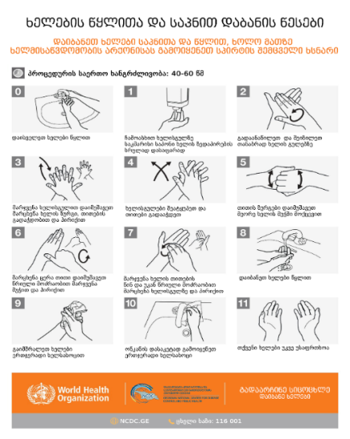
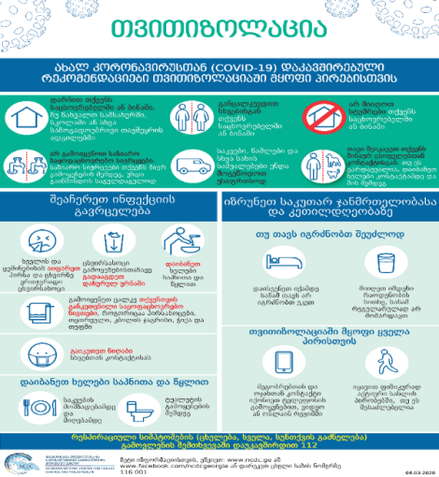
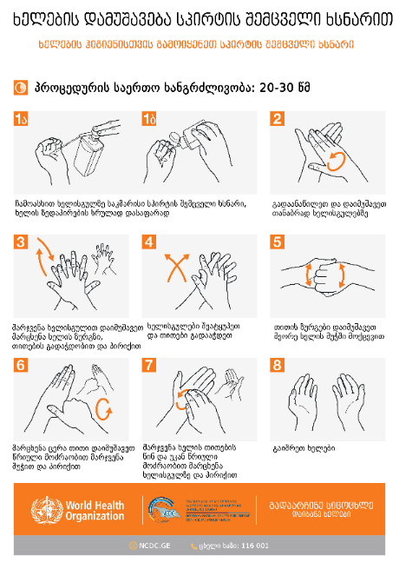
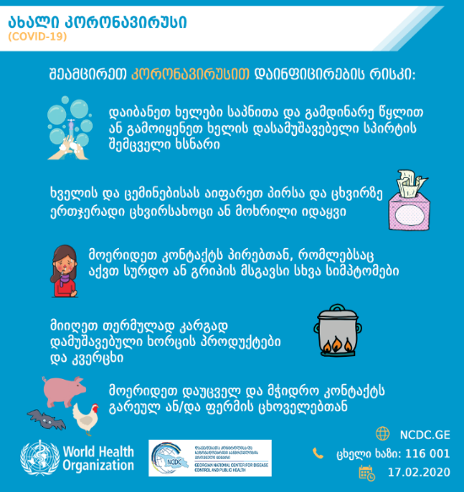

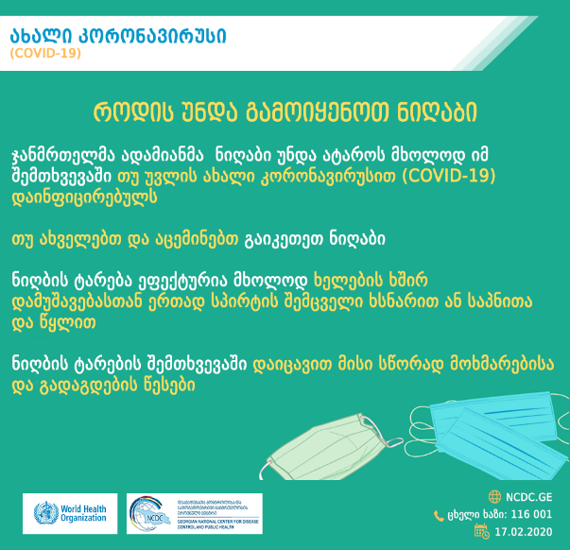


Slide 21
Thanks for your attention!

